Slide 1
Online Chatbot based ticketing system
PIP4004 University Project
Review - 4
Batch Number: 8IST-1
Name | Roll Number
Chirag | 20211IST0009
Rakesh K | 20211IST0001
Sameer Basha | 20221LIT0002
Arsalan Ali Khan | 20211IST0022
Under the Supervision of,
Dr. Pallavi R
HOD
School of Computer Science and Engineering,
Presidency University.
Name of the Program: Information Science and Technology
Name of the HoD: Dr. Pallavi R
Name of the Program Project Coordinator: Srinivas Mishra
Name of the School Project Coordinators: Dr. Sampath A K

Slide 2
Introduction
This project aims to develop an AI-powered chatbot-based ticketing system that enables visitors to book tickets, make secure payments, and receive instant assistance through a conversational interface. The chatbot will be accessible via websites ensuring ease of use. Impacting the visitor experience. With advancements in Artificial Intelligence (AI) and chatbot technology, museums can digitally transform their ticketing process to improve efficiency and accessibility. By implementing this chatbot-based solution, museums can streamline ticketing operations, improve customer engagement, and create a smarter, more convenient experience for visitors worldwide.

Slide 3
Literature Review
Application of Chatbots and Virtual Assistants in Ticket Booking System
Guravana Bhavani Shankar, Mr. Nunna Suresh, Dr. T. Vara Lakshmi. Research indicates that AI-powered chatbots and virtual assistants enhance museum ticketing systems by automating bookings, providing real-time support.
Source: IRJAEM
Chatbots in Museums: Is Visitor Experience Measured?
Kamila Štekerová. Chatbots enhance museum interactivity by integrating AI, gamification, and augmented reality, evolving from virtual guides to intelligent conversational partners. Future development focuses on emotion-aware interactions, accessibility, data security, and seamless visitor integration.
Source: Sciendo
Chatbot Integration in Ticketing Systems: Transforming Museum Ticketing This paper proposes the use of AI-based chatbots to streamline customer service in museum ticketing systems, enhancing visitor engagement and operational efficiency.
Source: IJRAR
Towards Implementing an AI Chatbot Platform for Museums" This research discusses the development of 'MuBot,' a chatbot platform designed to offer interactive and human-centered storytelling in museum environments.

Slide 4
Literature Review
Chatbot Adoption in travel and tourism services
Ms Khan Zainab Irfan,Prof Dr.Kirti Muley. The chatbot is a tool that facilitates the provision of answers to (frequently asked) questions and stimulates user action. Source: IJCRT
A Comparative Analysis of Customer Service Chatbots: Efficiency, Usability and Application
Kefaiat Lamia Ehsani, Ehsanur Rahman Rhythm, Md Humaion Kabir Mehedi and Annajiat Alim Rasel. A systematic review of the use of chatbots in customer service, highlighting their effectiveness in automating ticket resolution and improving customer satisfaction.
Source: ResearchGate
Enhancing Art Museum Experience with a Chatbot Tour Guide" This paper explores the implementation of a chatbot tour guide aimed at improving visitor engagement and learning in art museums.
Source:KTH

Slide 5
Existing method Drawback
Technical Limitations:
Some chatbots rely on predefined rules and cannot handle complex or unexpected user queries effectively.
User Experience Issues:
Many chatbots are not designed with a deep understanding of visitor behavior, leading to a lack of engagement.
Visitors may find chatbots impersonal, especially older generations who are less familiar with AI interactions.
If the chatbot fails to provide helpful responses, visitors may abandon it quickly, leading to low adoption rates.
Security and Privacy Concerns:
Visitors may be hesitant to share personal information, such as payment details for ticketing, due to data security concerns.
Chatbots integrated into social media platforms (e.g., Facebook Messenger) may face privacy challenges related to data sharing.

Slide 6
Proposed Method
System Architecture
The architecture consists of the following components:
User Interface (UI)
Available on museum website.
Supports text-based interactions.
Ticketing System Integration
Connects with the museum’s ticketing software for real-time seat availability, pricing, and booking confirmation.
Secure payment gateway integration.
Visitor Personalization Module
Uses AI to recommend tickets, discounts, and exhibits based on visitor preferences.
Saves visitor history for repeat customers to offer faster booking.
Security & Data Privacy
Implements end-to-end encryption for secure payment transactions.

Slide 7
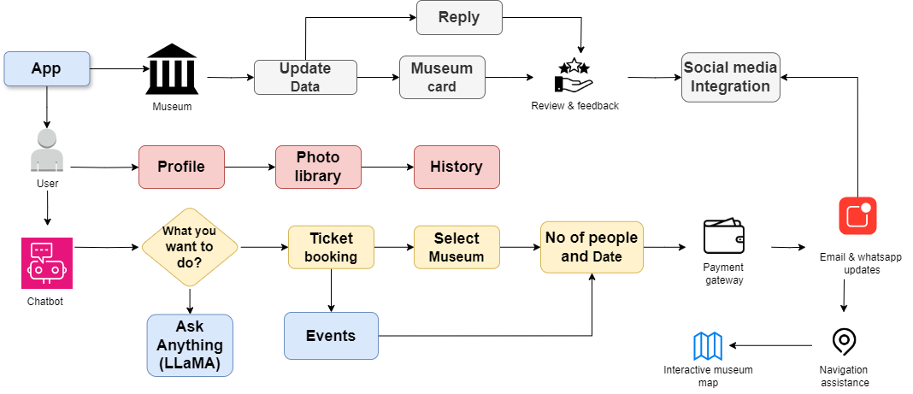
Architecture Diagram

Slide 8
Modules
User Interaction Module
Purpose: Manages visitor interactions via text, voice, and multimedia interfaces.
Ticketing & Reservation Module
Purpose: Facilitates real-time ticket booking, payments, and QR code generation.
Personalization & Recommendation Module
Purpose: Enhances visitor experience by suggesting events, exhibits, and discounts
Security & Privacy Module
Purpose: Ensures secure transactions, data protection, and compliance with privacy laws.
Integration & API Module
Purpose: Connects chatbot with third-party systems and museum infrastructure.

Slide 9
Requriments
Frontend: React.js - For building a user-friendly interface with accessibility and multilingual support Backend: Node.js (Express)/python(Django)/java – For handling business logic, data processing, and scalability
Cloud & DevOps: AWS/Microsoft Azure/GitHub actions & Jenkins- For scalability, cost-effectiveness, and efficient handling of high volumes
Automation and AI/ML: Tensorflow/PyTorch- To reduce human error and improve customer support with AI Database: PostgreSQL / MySQL – For storing customer data, analytics, and multilingual content Data Analytics: Data warehousing/Visualiztion Tools(Power BI)- For insights and reporting

Slide 10
Analysis of Problem Statement
Scalability for High Volumes
Infrastructure that can handle large amounts of data or requests without performance issues.
Customer Support Optimization
Need for faster and more personalized customer service solutions (e.g., chatbots, AI support).
Tools to reduce response times and improve customer satisfaction.
Cost Efficiency
Need for a solution that reduces operational costs while maintaining high service quality.
Automation and resource optimization to achieve cost-effectiveness.
Data Collection and Analytics
Systems to gather, store, and analyze customer interactions, trends, and feedback.
Actionable insights for decision-making, forecasting, and performance monitoring.
Accessibility and Inclusivity
Adherence to accessibility standards to make the solution usable for everyone, including individuals with disabilities.
User-friendly design for diverse audiences.
Error Reduction
Implementation of validation mechanisms, automation, and consistent workflows to minimize human errors.
Training or tools to ensure accuracy in data and service delivery.

Slide 11
Objectives
Book tickets seamlessly through a chatbot available on websites
Receive instant responses to FAQs about museum hours, ticket prices, ongoing exhibitions, and guided tours.
Make secure online payments using multiple payment gateways while ensuring data privacy.
Obtain personalized recommendations based on visitor preferences and history.
Reduce dependency on human staff, minimizing workload and operational costs for museums.

Slide 12
Methodology
1. Research & Requirement Analysis
Conduct surveys and analyze existing ticketing systems to identify challenges. Gather user requirements for chatbot interaction, payment processing, and museum management.
2. System Design & Architecture
Define system architecture, including chatbot AI, database, and payment gateway integration. Design user flow for seamless interaction and ticket booking. Select technologies such as Google Dialogflow, Python (Flask/Django), React.js, and MySQL.
3. Chatbot Development & Integration
Develop an AI-powered chatbot to handle ticket booking, FAQs, and real-time assistance. Implement Natural Language Processing (NLP) for user-friendly interactions. Integrate museum ticketing databases and payment gateways for secure transactions.

Slide 13
Methodology
4. Testing & Validation
Perform unit testing on chatbot responses and booking functionality. Conduct user acceptance testing (UAT) with real museum visitors. Ensure security compliance for data protection (GDPR, encryption).
5. Deployment & Maintenance
Deploy the chatbot on cloud platforms (AWS/Google Cloud). Monitor chatbot performance and optimize AI responses. Implement continuous updates based on visitor feedback and system analytics.

Slide 14
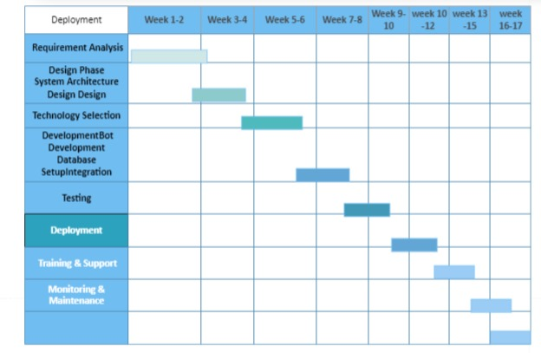
Gantt Chart

Slide 15
Expected Outcomes
Efficient & Automated Ticket Booking
Instant ticket purchases via chatbot, reducing wait times,Secure online payments with multiple payment options,QR-based e-tickets for contactless entry and convenience.
Cost & Workforce Optimization
Reduces manual workload, lowering operational costs. Automated customer service, minimizing human intervention. Increases efficiency in ticketing and visitor management.

Slide 16
Conclusion
The implementation of an AI-powered chatbot-based ticketing system for museums presents a smart, efficient, and user-friendly solution to modernize visitor management. By integrating automated ticket booking, secure payment processing, and real-time customer support, the system ensures a seamless and convenient experience for visitors.
This project effectively reduces wait times, enhances accessibility with multilingual support, and optimizes museum operations by minimizing manual efforts. The chatbot’s ability to provide personalized recommendations based on visitor interests further improves engagement and satisfaction.

Slide 17
References
ISSN: 2321-9653; IC Value: 45.98; SJ Impact Factor: 7.538 Volume 12 Issue X Oct 2024- Available at www.ijraset.com 791 ©IJRASET: All Rights are Reserved | SJ Impact Factor 7.538 | ISRA Journal Impact Factor 7.894 | Chat-Bot Based Ticketing System Using Dialogflow and Llama LLM.
Toward human-level performance with end-to-end, transaction-based dialog systems Bill Byrne*, Karthik Krishnamoorthi*, Saravanan Ganesh*, Mihir Sanjay Kale Google, Mountain View, CA billb,krishnamoorthi,srrvnn,mihirkale@google.com.
https://doi.org/10.47392/IRJAEM.2024.0221 Application of Chatbots and Virtual Assistants in Ticket Booking System.
Source - Online Chatbot Based Ticketing System Priya Kumari, Shruti Kumari, Simran Jaiswal, Siddhant Chaturvedi, Sahil Kumar Jha, Pratham Chaturvedi Oriental Institute of Science & Technology, Bhopal (MP), India

Slide 18
Thank You

